Slide 1
Low Power Jamming Mitigation PDR
Presented: 12/14/18
Senior Design I
By: Bryce Reese, Gary Visser, Alex English, Eric Routhier

Slide 2
Problem
Jamming of radio frequency signals has been a problem since the advancement of technology during World War II
Jamming today, while technically illegal, is a huge issue as the technology to jam signals is easily obtainable for a small cost
The problem of Radio Frequency jamming can affect consumers, Governments, Militaries, and companies for signals big and small
Wireless mobile networks are easily disrupted by low power transmissions, making information loss a major risk

Slide 3
Our Project Proposal
Design a countermeasure system for a multi-nodal wireless network that combines various detection, localization, and mitigation methods techniques derived from research and testing
A base station (laptop) will monitor received signal strength (RSS) from all nodes to calculate a known distance, in the event of a jamming attack, RSS will increase significantly, alerting the system. Nodes will be classified into three categories based on the location of the attack:
Jammed: Node currently being attacked, information lost
Barrier: Node is adjacent to a jammed node, transmission is secure for now
Unharmed: Node is not adjacent to a jammed node, transmission is safe
Network channel will be switched by base station for all unaffected nodes, jammed nodes will follow suit via psuedo-random sequence.

Slide 4
Justification
Jamming is an issue for not only the military, but for big companies and the general public as well
Jammed military comms can cost soldiers their lives or make missions into failures
Illegally purchased jammers can be very dangerous near airports
Oversaturated Wi-Fi and Bluetooth can lead to a very weak signal

Slide 5

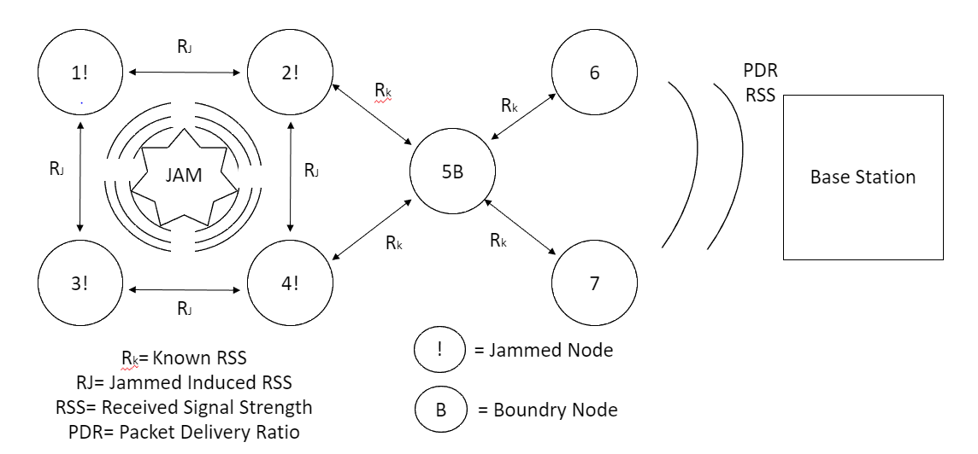
Diagram of Ideal System

Slide 6
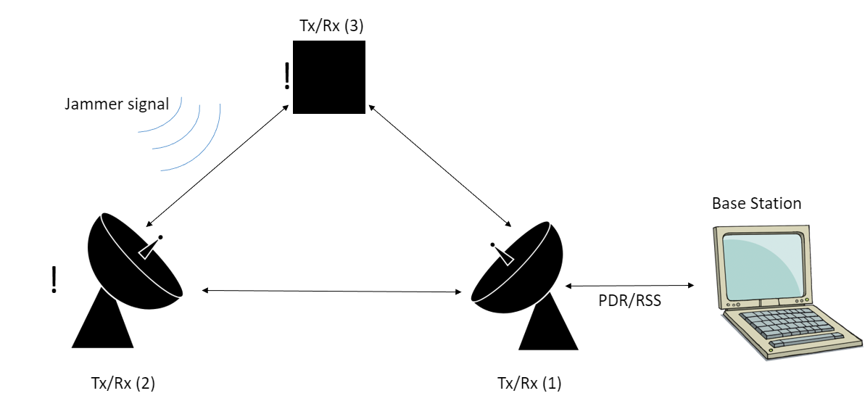
Diagram of Constrained System

Slide 7
Multiple Solutions
Design a multi-nodal wireless network that is monitored indefinitely by a base station
Low power signals make it easier to make without expensive equipment
Static System as opposed to mobile system
Heritage, much more research and development, outside of scope of the project
High power, UHF/VHF communication, testing will be difficult to obtain permits for in the region
Using Node redirection a signal can be redirected around an isolated jammer.
Requires equipment including more Tx/Rx systems that are out of the foreseeable budget.
Random Frequency hopping in strings of packets that are decoded on the Base Station.
Requires equipment including wideband arrays that are out of the foreseeable budget.

Slide 8
Requirement Specifications
Physical: standard node may be small and safely stored from interference
Software needs to operate with the node system and frequency hopping and also be able to detect and localizing the jammer (GNU, Python, Raspian)
Outputs:
Low power radio waves
Jamming radio waves
Report alerts on jamming, status of nodes. (clear, not clear, frequency level for transmitting)

Slide 9
Requirement Specifications (Performance)
Be able to transmit reliably across a distance regardless of jamming
It must be able to quickly detect jamming in less than a minute
It can transmit on both frequency ranges (2.4, 2.45 or even 2.5 GHz)
Needs to run off low power, from a battery supply or extension cord

Slide 10
Requirement Specifications (Testing)
Nees to be able to operate in an open air environment
10 to 15 yard field test
Test will be in a location free from many stray radio waves around area
Must abide by FCC regulation
High level Jamming is illegal in the USA

Slide 11
Assumptions and Constraints
Assumptions
Materials
3-4 Micro-computers (Raspberry Pis)
Base station (Laptop)
Power source
Technology
Coding language to work with Micro-computers (Python for Pis)
Software to run the tests (GNURadio)
Virtual machine to run the software
Financial
Between 4 group members, very limited budget
Logistical
Testing must be done in rural area
Group messaging should be available for team

Slide 12
Assumptions and Constraints Cont.
Constraints
Limitations of project manager
Need to find a mentor that has understanding of CE, AE, and EE.
Anticipated barriers to completion
FCC regulations (will need to verify the use of low energy jamming for educational use)
Conditions necessary to create and maintain a private broadcast
Funds are tight so project may need to be scaled down
Anticipated barriers to large scale implementation
Budget
Implementation requires up to 7-8 nodes
Size
Scaled down project to match budget
May cause problems while transmitting
Generalizability of project findings
With project being small scale, certain factors may need to be isolated

Slide 13
Project Budget and Support
No Restrictions (appx. $390)
5 nodes (Tx/Rx Capable): Raspberry Pi 3 ($90) Two supplied by Fusion Lab
Stronger Bluetooth Emitters ($100)
Power supply: MoPi ($40 ea. Or $120 for 3)
Ground station: Simple computer, LINUX compatibility ($80)
Software: Open-source code ($0)
Limited(appx. $30)
3 nodes (Tx/Rx Capable): Raspberry Pi 3 ($30) Two being supplied by fusion lab
Power supply (x3): EE Lab equipment ($0 if all components are available)
Ground Station (laptop): Personal laptop fitted with Linux and software ($0)
Software: Open source development ($0).

Slide 14
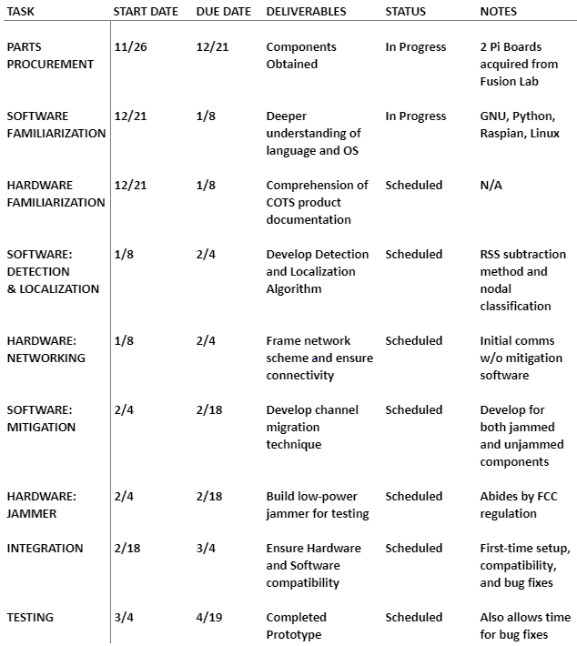
Initial Project Schedule

Slide 15
Literature Review
K. Grover, A. Lim, and Q. Yang. "Jamming and Anti-jamming Techniques in Wireless Networks: A Survey", International Journal of Ad Hoc and Ubiquitous Computing, vol. 17, no. 4, pp 197-215, 2014. Retrieved from https://www.cs.montana.edu/yang/paper/jamming.pdf
P. Rupani, N. Tada. “Literature Survey on Jamming Attack in Wireless Adhoc Network”, International Journal of Engineering Development and Research, vol. 5, no. 2, pp 434-443, 2017. Retrieved from https://www.ijedr.org/papers/IJEDR1702075.pdf
N. Sufyan, N. Saqib, & M. Zia. (2013, August 15). “Detection of jamming attacks in 802.11b wireless networks”, EURASIP Journal on Wireless Communications and Networking (n.p.). Retrieved from https://www.springer.com/engineering/signals/journal/13638
Huffman, M. (2012, March 2). The Effects of cognitive jamming on wireless sensor networks used for geolocation. Air Force Institute of Technology [University]. Retrieved from http://www.dtic.mil/dtic/tr/fulltext/u2/a557486.pdf
Pardhasaradhi, A., Kumar R. (2013, April). “Signal Jamming and its Modern Applications”, International Journal of Science and Research, vol. 2, iss. 4, pp 429-431, 2013. Retrieved from https://www.ijsr.net/archive/v2i4/IJSRON2013808.pdf

Slide 16
Low Power Jamming Mitigation PDR
Questions?

